Slide 1
http://www.vidyanidhi.com/
ketkiacharya.net@gmail.com
Ketki Acharya
From: SM VITA ATC of CDAC
ketkiacharya.net@gmail.com

Slide 2
DatabseFirst
CREATE TABLE [dbo].[Authors] (
[AuthorId] INT IDENTITY (1, 1) NOT NULL,
[FirstName] NVARCHAR (MAX) NOT NULL,
[LastName] NVARCHAR (MAX) NOT NULL,
CONSTRAINT [PK_Authors] PRIMARY KEY CLUSTERED ([AuthorId] ASC)
);
CREATE TABLE [dbo].[Books] (
[BookId] INT IDENTITY (1, 1) NOT NULL,
[Title] NVARCHAR (MAX) NOT NULL,
[AuthorId] INT NOT NULL,
CONSTRAINT [PK_Books] PRIMARY KEY CLUSTERED ([BookId] ASC),
CONSTRAINT [FK_Books_Authors_AuthorId] FOREIGN KEY ([AuthorId]) REFERENCES [dbo].[Authors] ([AuthorId]) ON DELETE CASCADE
);

Slide 3
Install-Package Microsoft.EntityFrameworkCore –version 8.0.0
Install-Package Microsoft.EntityFrameworkCore.SqlServer –version 8.0.0
Install-Package Microsoft.EntityFrameworkCore.Tools –version 8.0.0
Install-Package Microsoft.EntityFrameworkCore.Design–version 8.0.0

Slide 4

Entity Framework Core can be used with .NET Core or .NET 4.6 based applications
EF Core is not a part of .NET Core and standard .NET framework. It is available as a NuGet package..
we need to install the NuGet package for the provider of the database we want to access. Here, we want to access MS SQL Server database, so we need to install
install EF tools to execute EF Core commands. These make it easier to perform several EF Core-related tasks in your project at design time, such as migrations, scaffolding, etc.
Microsoft.EntityFrameworkCore.Design contains all the design-time logic for Entity Framework Core. It's the code that all of the various tools (PMC cmdlets like Add-Migration, dotnet ef & ef.exe) call into.
If you don't use Migrations or Reverse Engineering, you don't need it.
Microsoft.Extensions.Configuration.Json
To read connection string from appsettings.json

Slide 5
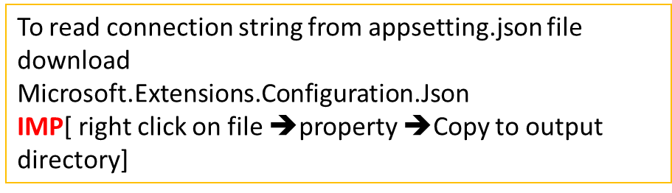
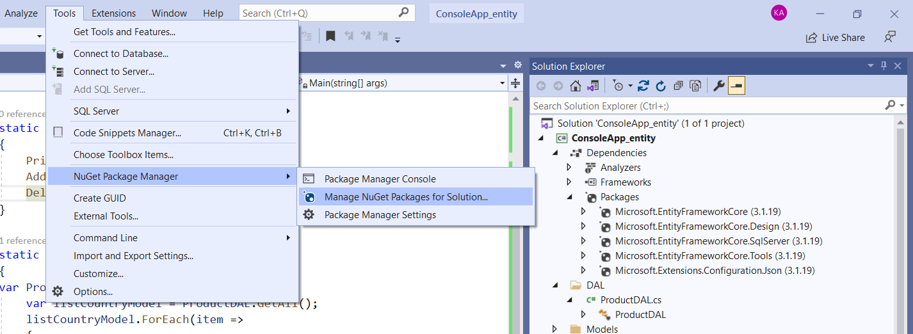
Reverse Engineering
Using Manage NueGet Packages for Solution

Slide 6
Scaffold-DbContext "Data Source=(localdb)\ProjectModels;Initial Catalog=EntityAuthBook;Integrated Security=True" Microsoft.EntityFrameworkCore.SqlServer –OutputDir Models –Context SampleContext –tables "Authors", "Books" -DataAnnotations
Scaffold parameter➔
Connection string
Dataprovider
-OutputDir Modes
-Context filename
Tables “” , “ “
-DataAnnotation

Slide 7
namespace CADbfirst.Service
{
internal class BookService
{
private readonly SampleContext db;
internal BookService()
{
db = new SampleContext();
}
public void Addmany()
{
var author = new Author
{
FirstName = "William",
LastName = "Shakespeare",
Books = new List<Book>
{
new Book { Title = "Hamlet" },
new Book { Title = "Othello" },
new Book { Title = "MacBeth" }
}
};
db.Add(author);
db.SaveChanges();
}
public void AddBook(Book obj)
{
db.Add(obj);
db.SaveChanges();
}
public void RemoveBook(int Id)
{
Book book = db.Books.FirstOrDefault(x => x.BookId == Id);
if (book != null)
{
db.Remove(book); // Book Deleted
db.SaveChanges();
}
}
public void UpdateBook(Book obj)
{
SampleContext db1 = new SampleContext();
db1.Update(obj);
db1.SaveChanges();
}
public IEnumerable<Book> Display()
{
return db.Books.Include((a) => a.Author).ToList<Book>();
}
public void Display(string title)
{
FormattableString sql = $"SELECT * FROM Books WHERE Title = {title}";
var book = db.Books.FromSql(sql).FirstOrDefault();
Console.Write(book.Title);
var books = db.Books.FromSql($"EXECUTE dbo.GetMostPopularBooks {title}").ToList();
Console.Write(book.Title);
}
public void DeleteAuth(int id)
{
var auth = new Author { AuthorId = id };
db.Remove(auth); // Book Deleted
db.SaveChanges();
}
}
}

Slide 8
using CADbfirst.Models;
using CADbfirst.Service;
namespace CADbfirst
{
internal class Program
{
static void Main(string[] args)
{
Console.WriteLine("Hello, World!");
BookService bookservice = new BookService();
var book = new Book
{
Title = "C#",
Author = new Author
{
FirstName = "Rajan",
LastName = "Kanetkar"
}
};
//Add Author add book
bookservice.AddBook(book);
//Add multiple record
bookservice.Addmany();
var bookup = new Book
{
Title = "Let us C",
BookId = 6,
AuthorId = 4
};
bookservice.UpdateBook(bookup);
//servicebook.RemoveBook(5);
// bookservice.DeleteAuth(3);
var d = bookservice.Display();
foreach (var item in d)
{
Console.WriteLine($"{item?.Title} {item?.Author?.FirstName} {item?.Author?.LastName} {item?.BookId}");
}
}
}
}

